Slide 1

CAMPUS-OS
PREDICTING STUDENT PERFORMANCE USING REGRESSION ANALYSIS
Mini Project / 5th Sem/ BCS554
STUDENT NAME
1.Rishabh Singh 2400320100909
2.Rankendra Singh
2400320100890
3.Raj Rao
2400320100876
4.Rohit
2400320100925
SUPERVISOR NAME:
Dr. Shweta Roy

Slide 2
ABSTRACT
Objective: Predict student academic performance using regression-based machine learning.
Data: Analyze factors such as attendance, previous grades, demographics, and study behaviour.
Models: Compare Linear, Ridge, Lasso, and Random Forest Regression.
Evaluation: Measure performance using R², MAE, and RMSE.
Outcome: Identify the best-performing model and key factors affecting student performance.
Application: Support educational institutions in data-driven decision-making and early academic intervention.

Slide 3
Problem Statement
Why prediction is needed in education
Academic performance depends on multiple interacting factors.
Institutions often identify at-risk students only after final results.
Collected data is not always converted into proactive insight.
A transparent regression model can quantify influential factors.
Data collected
Late detection
Missed support

Slide 4
Objectives
From raw records to an interpretable prediction tool
Preprocess a real-world student dataset.
Explore relationships and influential features.
Train Linear, Ridge, Lasso and Random Forest regressors.
Visualize predictions and residual errors.
Compare models using R², MAE and RMSE.
Package the workflow into a reusable tool.

Slide 5
SCOPE of the Problem Statement
Data Preprocessing Module: cleaning, encoding and normalizing raw student records.
Exploratory Data Analysis: correlation heatmaps, distribution and trend visualizations.
Model Building: implementation of multiple regression algorithms for comparison.
Model Evaluation: quantitative comparison using R², MAE and RMSE across all models.
Future AI Layer: extension to classification-based risk categorization and integration with institutional dashboards.

Slide 6
Related Work and Research Gap
Nasution et al. (2024): Gender, absence rate, and prior GPA significantly influence final CGPA.
De Guzman et al. (2022): Multiple Linear Regression effectively predicts performance using admission and demographic data.
IEEE (2020): Feature selection/dimensionality reduction improves regression-based prediction.
Scientific Reports (2025): Comparing multiple ML models improves prediction accuracy and interpretability.
Research Gap: Most studies focus on a single regression model and institution-specific datasets.

Slide 7
Proposed Method
A standard, reproducible data-science workflow
Collect
Preprocess
Explore
Select features
Train models
Evaluate
Visualize / deploy

Slide 8
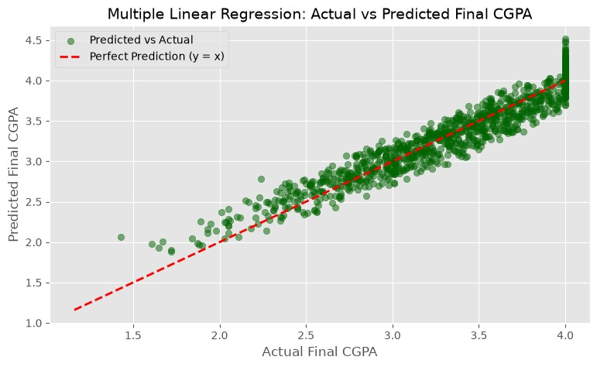
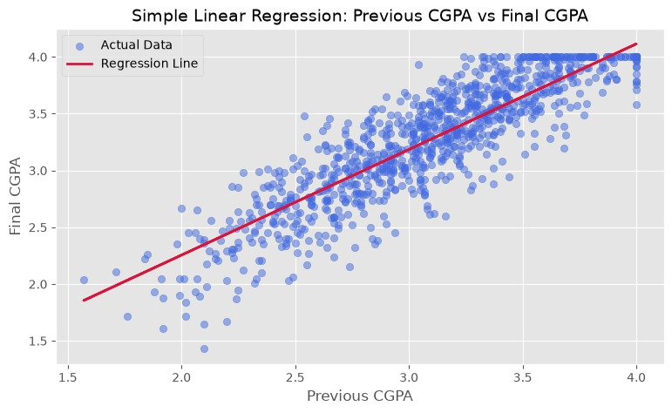
Outputs and Visualizations
Turning model results into actionable insight
Correlation heatmap and feature distributions.
Actual-versus-predicted performance plot.
Residual analysis to identify systematic errors.
Model comparison dashboard using R², MAE and RMSE.
Optional Streamlit or Flask interface for new predictions.

Slide 9
Technology Requirements
Software Requirements
Hardware Requirements
Category
Requirements
Optimal
Operating System
Windows 10/11,
Linux, or macOS
Language & Environment
Python 3.x in
Jupyter Notebook or
Minimum Specs
Recommended Specs
Google Colab
pandas, numpy,
Baseline hardware for project
Enhanced hardware for better
Data & Visualization
matplotlib, and
operation
performance
seaborn
Basic
Advnced
scikit-learn for mod-
Machine Learning
els and metrics;
statsmodels for
summaries
Storage Needs
Connectivity
UCI Machine
Required disk space for project
Network requirements for cloud
Dataset
Learning Repository
– Student
files
deployment
Performance Data
Set
Version Control
Git and GitHub
Essential

Slide 10
Applications
Early identification of students who may need academic support.
Helps teachers and institutions monitor student performance.
Supports data-driven academic decision-making.
Helps identify key factors affecting academic outcomes.
Can assist in developing personalized learning and intervention strategies.

Slide 11
Limitations
Limited to the available dataset and its quality.
May not consider all factors affecting student performance.
Model accuracy depends on the size and representativeness of the data.
Results may not generalize to all institutions or student groups.
Predictions indicate relationships but do not establish causation.

Slide 12
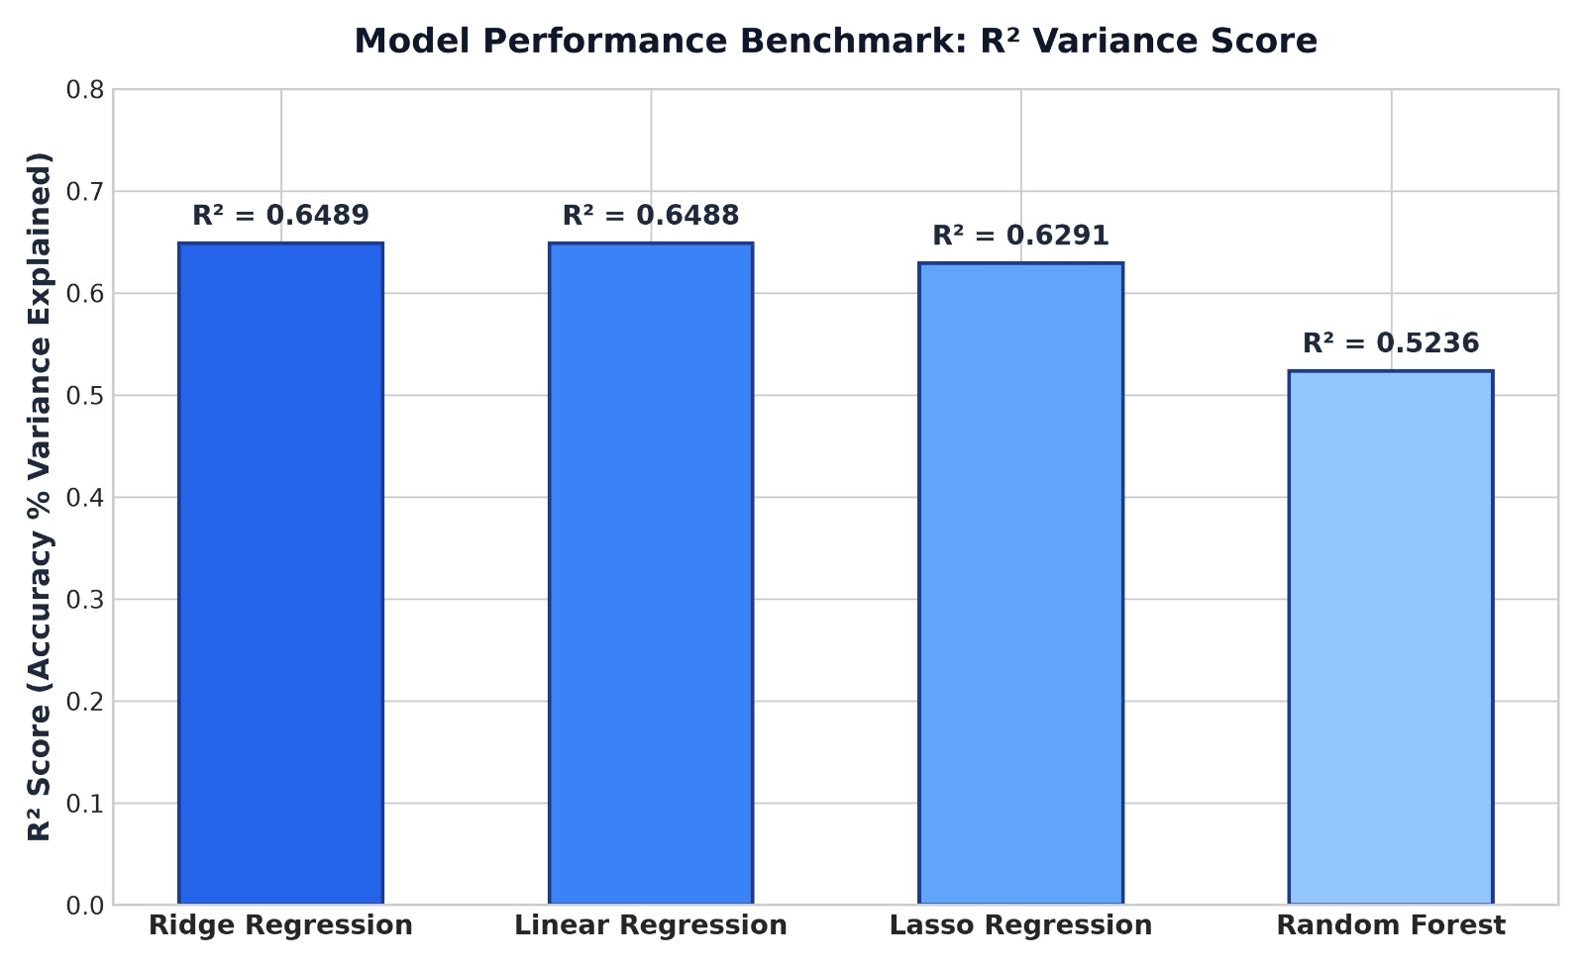
Conclusion and Future Scope
Expected Outcome
Develop a model to predict student performance.
Compare Linear, Ridge, Lasso, and Random Forest regression models.
Identify the best-performing model using accuracy metrics.
Analyze key factors affecting student performance.
Present results using simple visualizations
Conclusion
This project will use regression techniques to predict student performance and identify the factors that influence academic outcomes. Comparing multiple models will help determine the most effective and reliable approach for accurate prediction.

Slide 13
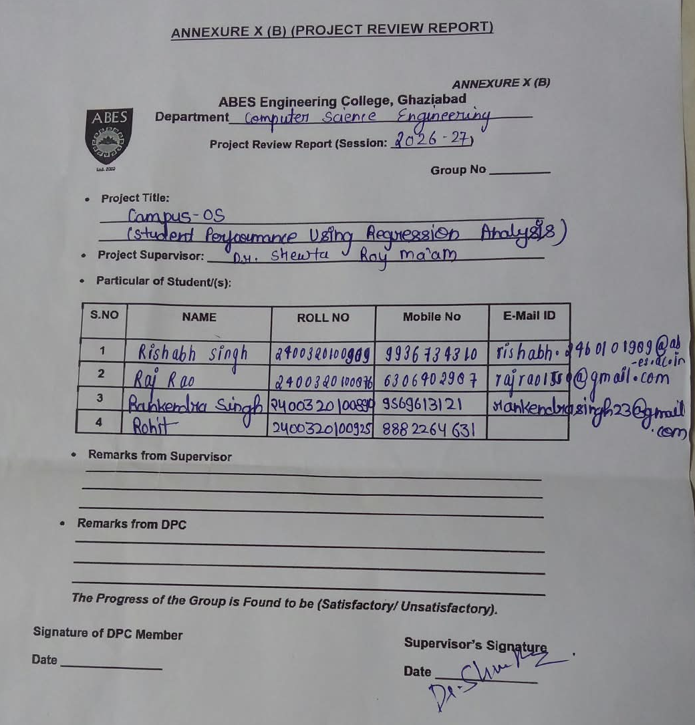
Annexure 10 B (Screenshot :Duly Signed by Supervisor)

Slide 14
References
De Guzman, K. et al. (2022). Predicting Students' Academic Performance Using Regression Analysis. American Journal of Educational Research, 10(11). https://pubs.sciepub.com/education/10/11/2/index.html
Students' Academic Performance Prediction using Regression: A Case Study (2020). IEEE Conference Publication. https://ieeexplore.ieee.org/document/9262346/
Student Performance Prediction with Regression Approach and Data Generation (2024). Applied Sciences, MDPI, 14(3), 1148. https://www.mdpi.com/2076-3417/14/3/1148
Cortez, P., & Silva, A. (2008). Using Data Mining to Predict Secondary School Student Performance. UCI Machine Learning Repository – Student Performance Data Set. https://archive.ics.uci.edu/dataset/320/student+performance
Scikit-learn Documentation. Machine learning in Python. https://scikit-learn.org/stable/documentation.html
Pandas Documentation. Python data analysis library. https://pandas.pydata.org/docs/

